Slide 1
Semester Intern Final Presentation
Jarveis Lam
Notes:
Hello! Im Jarveis and with me is Yee Fong. So we will be presenting on one of the project we have been working on over the past 2/3 months which is the Load Test Client

Slide 2
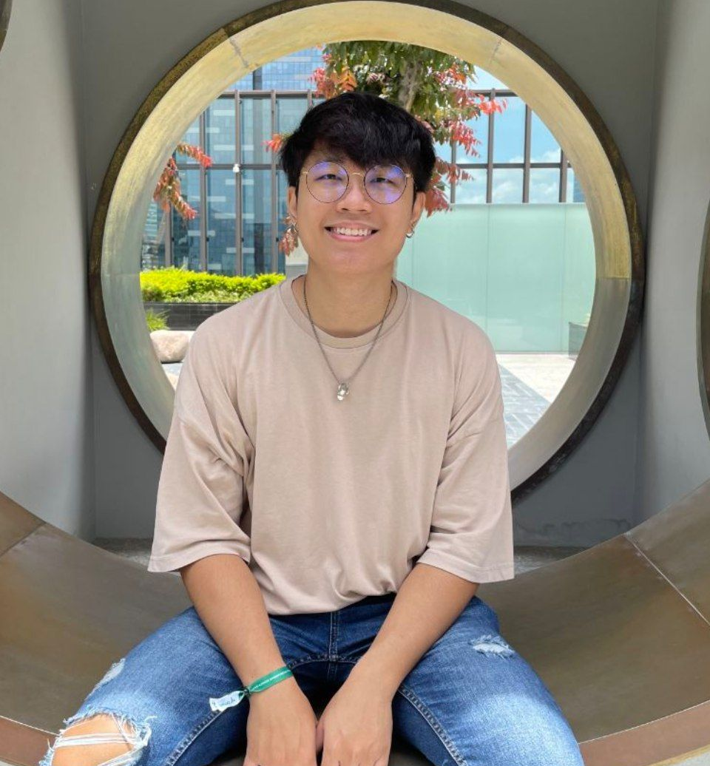
About me
Hello! I’m Jarveis Lam
Year 4 Computer Science, National University of Singapore
Part of the CONFIG team in PPD from May 2022 – October 2022
Manager: Prosenjit Biswas
Buddy: Liu Xunyu
Source placeholder

Slide 3
Internship Projects & Learning Points
Load Test Client

Slide 4
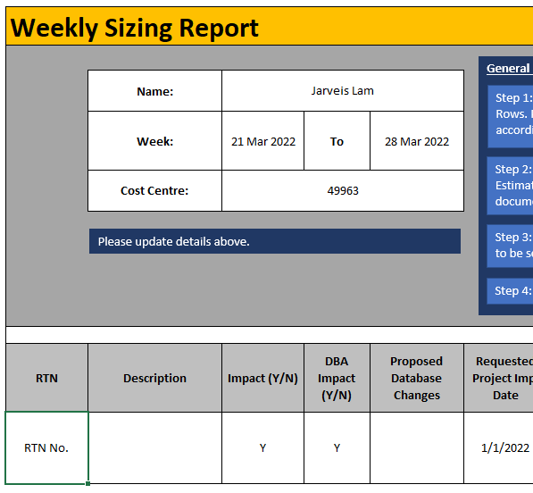
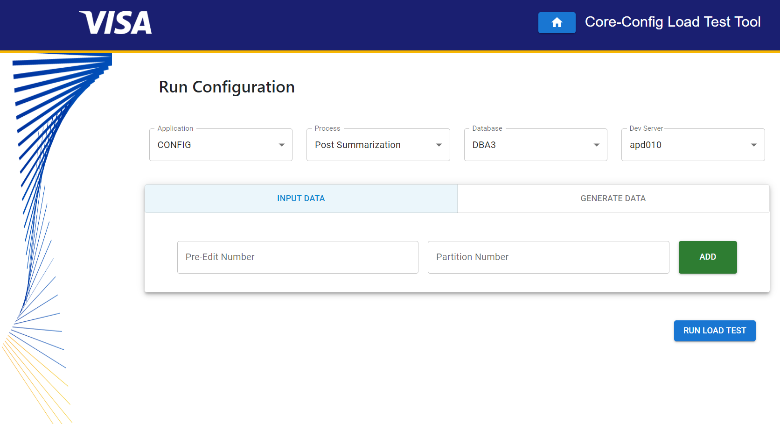
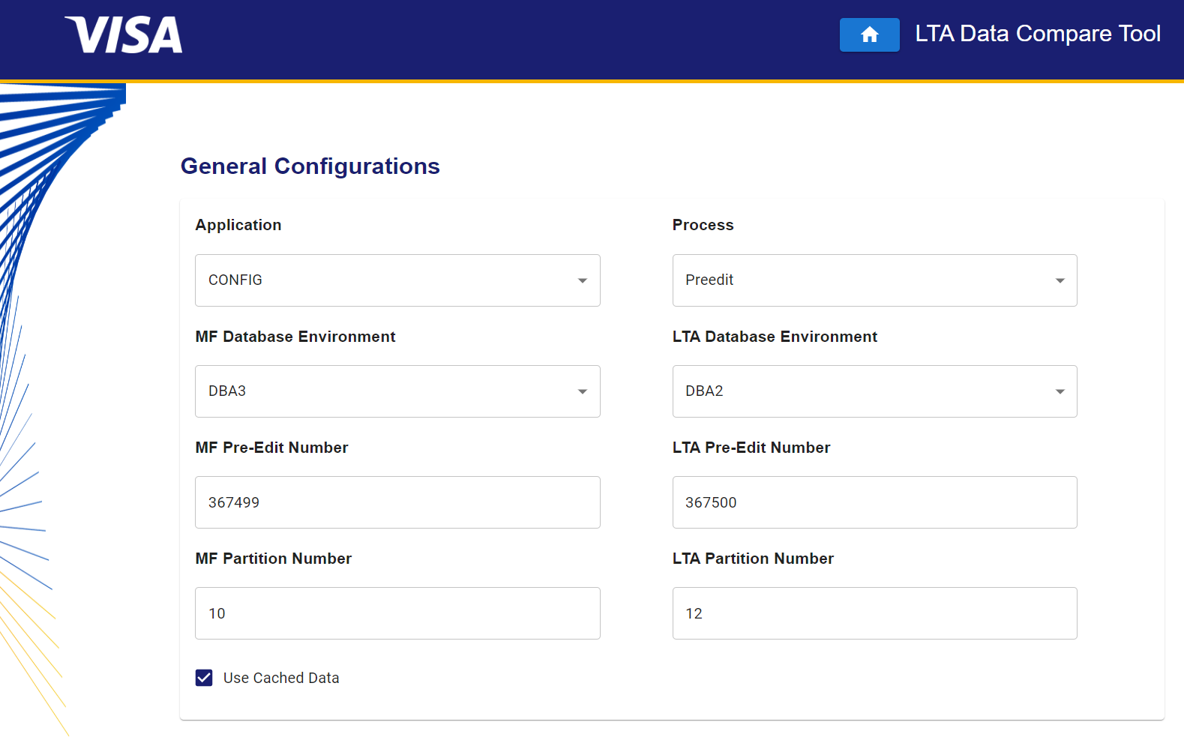
3 Major Projects
Different Goals & Different Journeys
Weekly Sizing Report Automation
Automate the team’s Sizing Process for new RTNs
Load Test Client
Developer Tool to help perform parallel testing on new microservices
Data Compare Tool Enhancement
Extend the functionality of the Developer Tool to help compare data (between MF and LTA services) from the Apply Process
Source placeholder

Slide 5
2 Major Projects
Different Goals & Different Journeys
Load Test Client
Developer tool to help perform parallel testing on new microservices
Data Compare Tool Enhancement
Extend the functionality of the Developer tool to help compare data (between MF and LTA services) from the Apply Process
Source placeholder

Slide 6
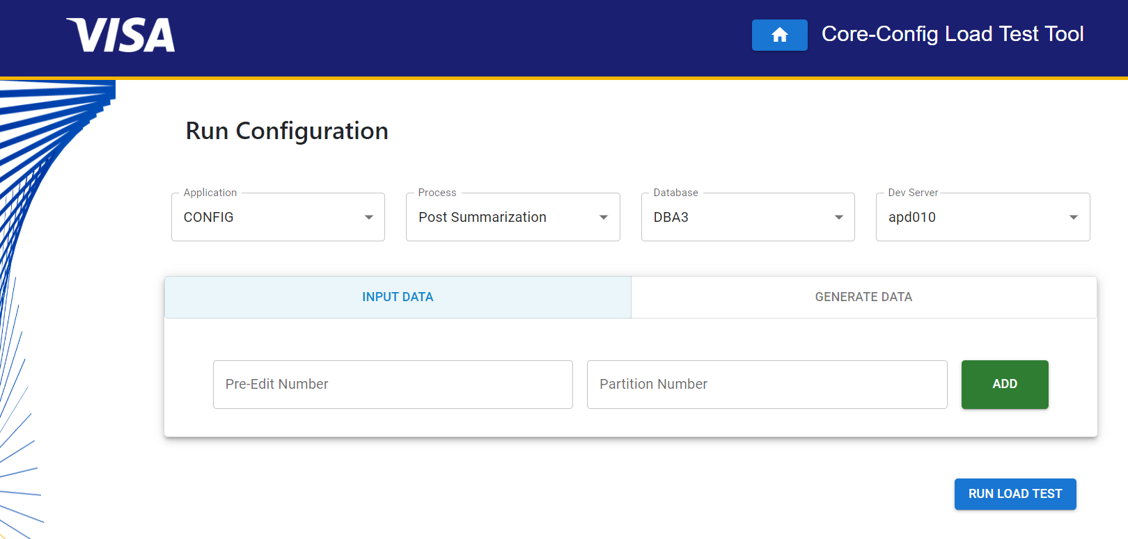
Load Test Client
Full stack project
Help Developers perform parallel testing on new microservices
As part of the LTA plans, ensure microservices can handle concurrent users/processes
Automate generation of test data for parallel tests
Impacts
Help to reduce time spent on
Setting up tests
Creating test data
Allow developers focus on ensuring these services are running as expected
New microservices will be built
Source placeholder

Slide 7
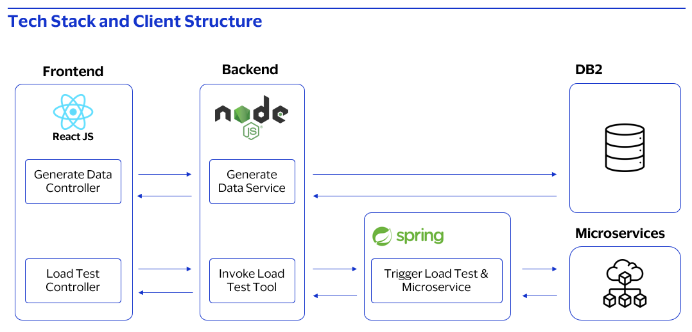
Learning Points
Building the Load Test Client
Tech Stack
Built with ReactJS for Frontend, NodeJS and Springboot for Backend server
Processes
Requirement gathering and scope refinement
Server and Deployment processes (CI/CD)
Soft Skills
Communicate ideas effectively and Collaborate with project partner and teammates
Presentation skills
Technical Demos
High Level Overviews
Documentation
Source placeholder

Slide 8
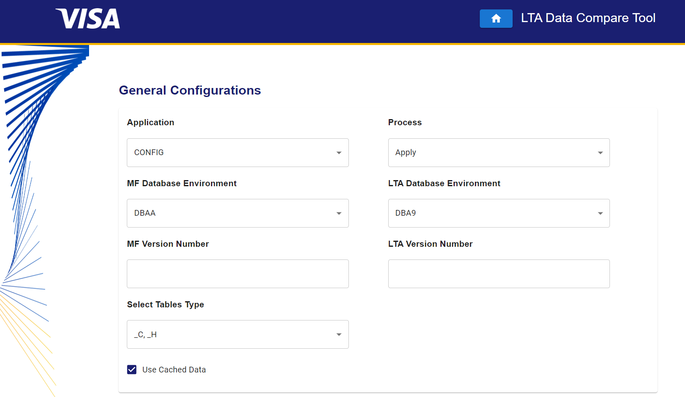
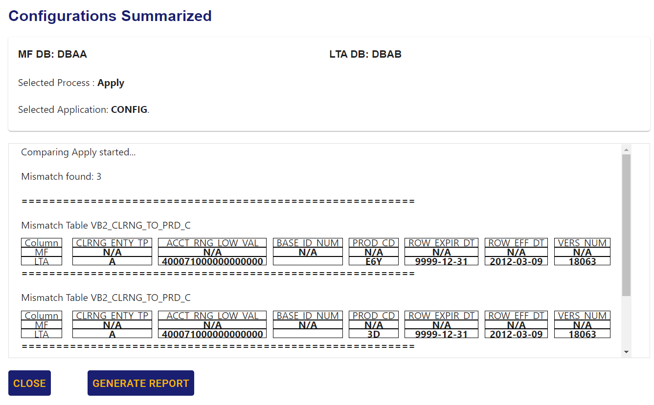
Data Compare Tool
Enhancing current features
Extend the current functionality of the Data Compare Tool
As part of the LTA plans, used to verify data created/edited by microservices
Current tool used for Pre-edit and Summarization processes
Extend for the Apply Process
Impacts
Allow developers to ensure microservices are operating correctly
Simplify checking of data without having to check individual tables
Source placeholder

Slide 9



Learning Points
Enhancing the Data Compare Tool
Tech Stack
Built with ReactJS for Frontend, NodeJS for Backend Server
Debug and trace code
Build on top of existing codebase
Processes
Creating testing plan and documentation
Unit testing and integration testing
Soft Skills
Ask questions and develop understanding of why
How to guide and help others so that others can learn and develop their own skills
Problem solving skills
React JS
Source placeholder

Slide 10
Journey with Visa
Load Test Client

Slide 11
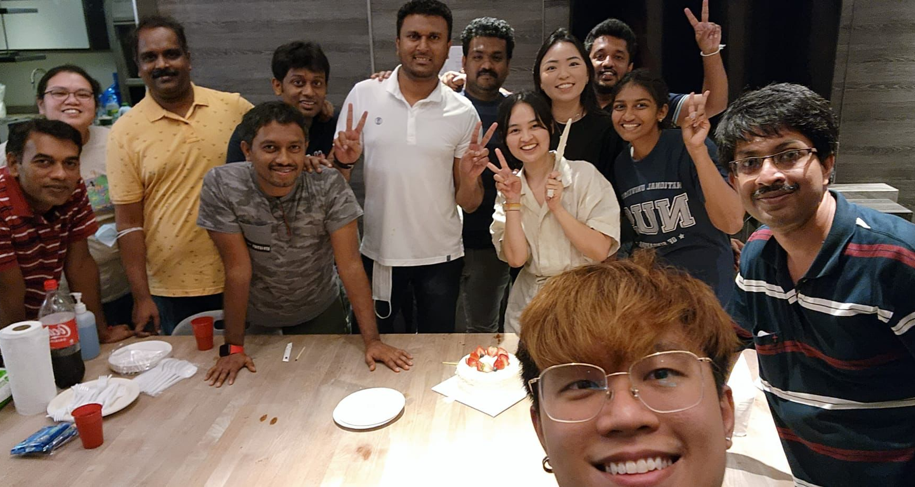
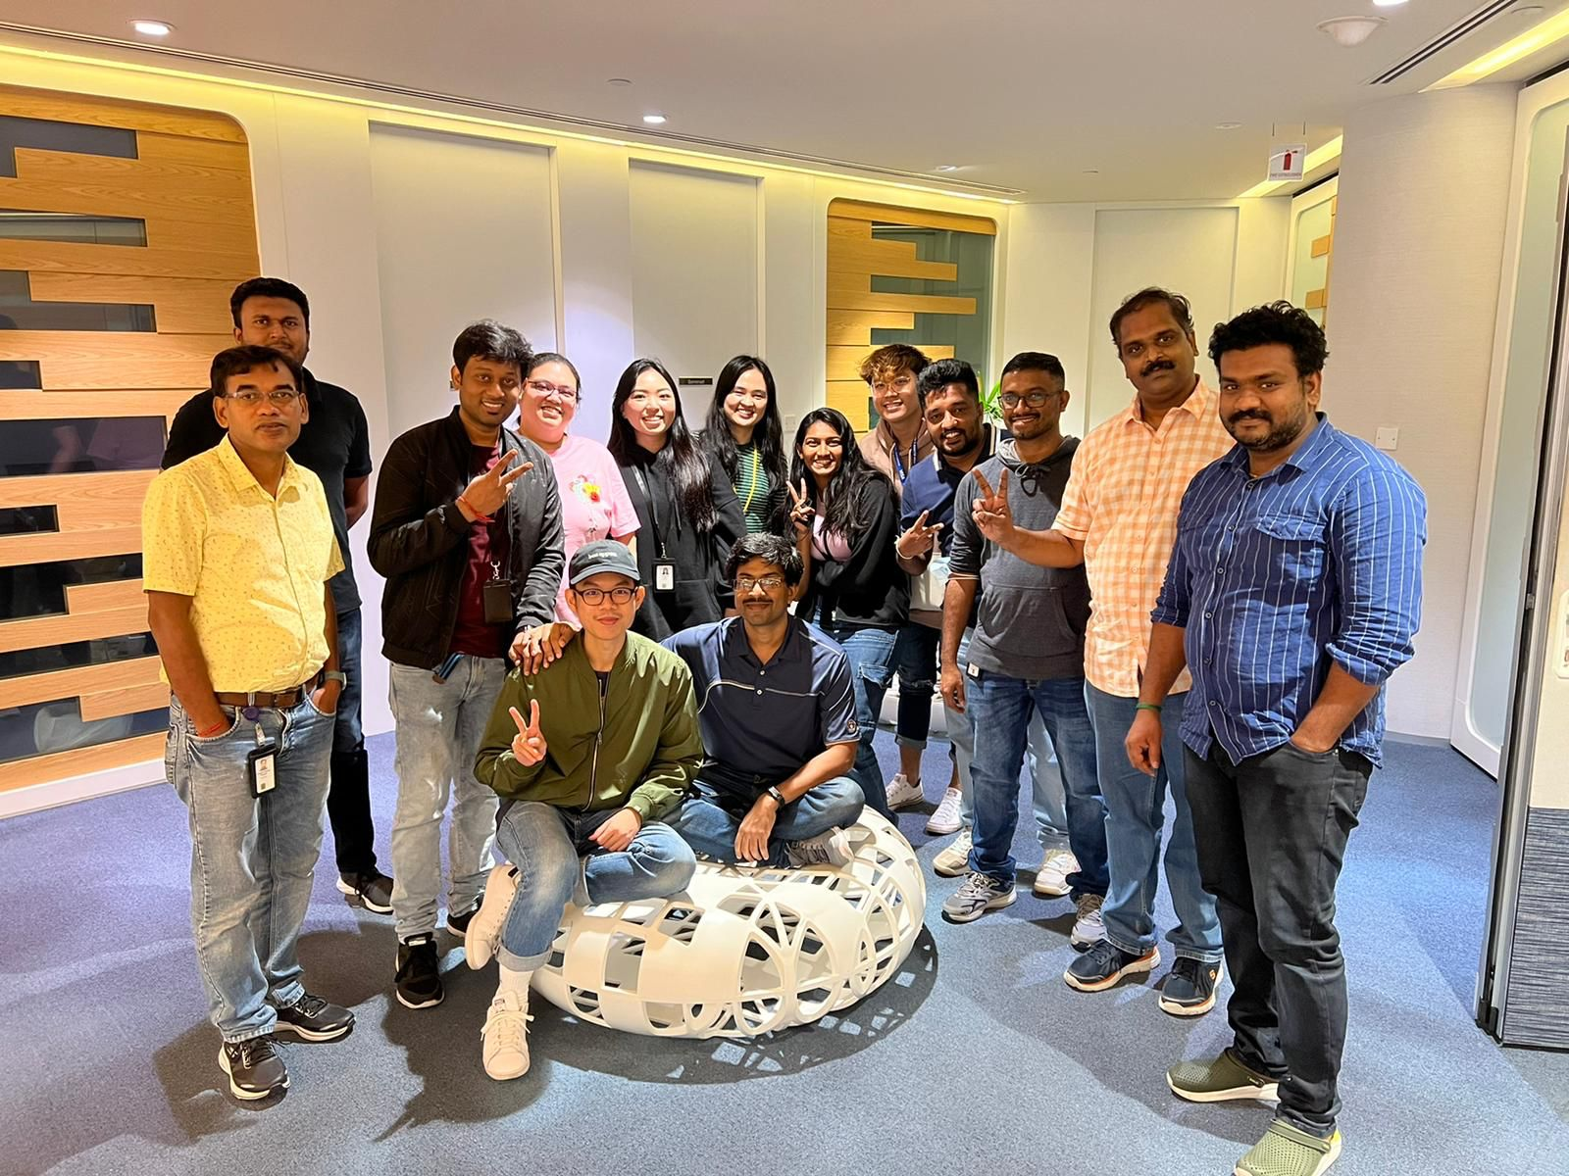
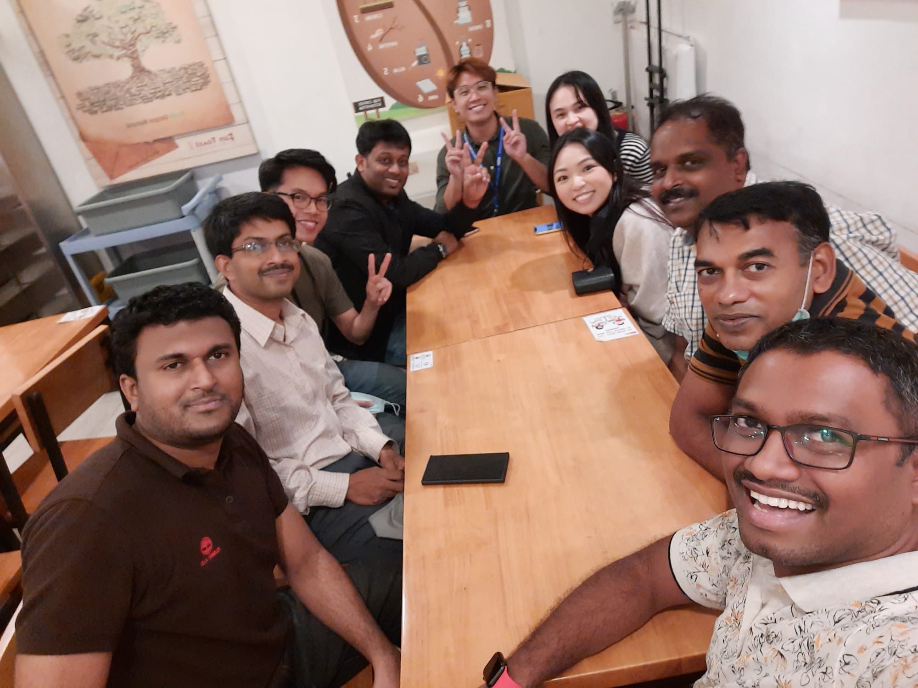



Team Events
Team bonding & Development opportunities

Slide 12
Notes:
With that, we have come to the end of our presentation. Before moving into Q and A, jarveis and i would like to take this opportunity to thank the team for their support throughout our project. They have been really approachable which made it easy for us when we require help from them. The team has also put in extra effort in organising trainings for us and has done an amazing job in helping us understand the responsibilities of the team more. We really enjoy how inclusive the team's culture is. We may be here for only a few months but we feel very blended into this big family. We also values how the team communicates openly all the time creating a very comfortable working environment.

